Slide 1
TDP 4 & Java 8, Stream it and Lambda it
19 May, 2017
Notes:
A lot of companies of big size of code base might think it's too hard or too risky to upgrade to java 8. But as you fall further behind, it just becomes even harder and riskier, and eventually you end up stuck with no upgrade path. This accumulation of technical debt slows down the entire development organization so keeping our stack current is a top priority here

Slide 2
Agenda
λ Expression
Stream API in a nut shell
Optional, remedy for NPE
Adoption in TDP 4
Q&A

Slide 3
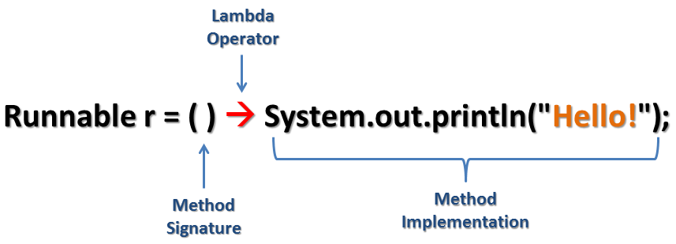
λ Expression
Notes:
lambdas as an instance of an interface type

Slide 4
λ Expression
List<String> names = Arrays.asList(“Steve", “Thomas", “Andy", “Shaojie");
// java 7 code for (String name : names) System.out.println(name);
// java 8 code with lambda names.forEach((String name) -> System.out.println(name));

Slide 5
λ Expression under the hood
Collections.sort(names, new Comparator<String>() { @Override public int compare(String a, String b) { return b.compareTo(a); } });
Collections.sort(names, (String a, String b) -> b.compareTo(a)); Collections.sort(names, (a, b) -> b.compareTo(a));

Slide 6

λ Expression
Anonymous function
Method without a declaration
Instance of a functional interface
Function is a first class citizen
Notes:
lambdas as an instance of an interface type

Slide 7
Functional Interface
Functional Interface @FunctionalInterface
Single Abstract Method (SMA) interface
Could have default method with implementation

Slide 8
Default Method
backward compatiblity
old interfaces can be used to leverage the lambda expression capability
‘Iterable’ interface
forEach
‘Collection’ interface
stream
parallelStream

Slide 9
Final or Effectively Final
For both lambda bodies and inner classes, local variables in the enclosing context can only be referenced if they are final or effectively final.
A variable is effectively final if it is never assigned to after its initialization.
No longer need to litter code with final keyword

Slide 10
Final or Effectively Final
int zero = 0; List<Person> sortedPersons = persons.stream() .sorted((p1, p2) -> (p1.getAge() - p2.getAge() > zero ? 1 : -1)) .collect(Collectors.toList());
Effective final
int zero = 0; zero = 0; List<Person> sortedPersons = persons.stream() .sorted((p1, p2) -> (p1.getAge() - p2.getAge() > zero ? 1 : -1)) .collect(Collectors.toList());
Non effective final,compile error incur
Error:(43, 66) java: local variables referenced from a lambda expression must be final or effectively final
Notes:
Lambda Expression section finished, question?

Slide 11

Stream

Slide 12
Scenario
Given a collection of Transactions : List<Transaction> transactions
Find out all transactions of type grocery
Sort them in decreasing order of transaction value
Return a list of transaction IDs : List<Integer> transactionIds

Slide 13
Solution before Java 8
// find the GROCERY type for(Transaction t: transactions){ if(t.getType() == TransactionType.GROCERY){ groceryTransactions.add(t); } }
// sort by value in descending order Collections.sort(groceryTransactions, new Comparator<Transaction>() { @Override public int compare(Transaction t1, Transaction t2) { return t2.getValue().compareTo(t1.getValue()); } });
// add to another List of Integer List<Integer> transactionIds = new ArrayList<>(); for(Transaction t: groceryTransactions){ transactionIds.add(t.getId()); }

Slide 14

Boilerplate Code

Slide 15
Solution with Stream
List<Integer> transactionsIds = transactions.stream() .filter(t -> t.getType() == TransactionType.GROCERY) .sorted(comparing(Transaction::getValue).reversed()) .map(Transaction::getId) .collect(toList());
Notes:
In my opinion Java 8 code is better because of following reasons:
Java 8 code clearly reflects developer intent of filtering, sorting, etc.
Developers express what they want to do rather than how they want do it by using a higher level abstraction in the form of the Stream API.
The Stream API provides a unified language for data processing. Now developers will have a common vocabulary when talking about data processing. When two developers talk about a filter function, you can be sure that they both are applying a data filtering operation.
No boilerplate code is required to express data processing. Developers no longer have to write explicit for loops, or create temporary collections to store data. All is taken care by the Stream API itself.
Streams do not modify your underlying collection - they are non-mutating.

Slide 16
Solution Comparison
Old Solution with Collection | New Solution with Stream
// find the GROCERY type for(Transaction t: transactions){ if(t.getType() == TransactionType.GROCERY){ groceryTransactions.add(t); } } // sort by value in descending order Collections.sort(groceryTransactions, new Comparator<Transaction>() { @Override public int compare(Transaction t1, Transaction t2) { return t2.getValue().compareTo(t1.getValue()); } }); // add to another List of Integer List<Integer> transactionIds = new ArrayList<>(); for(Transaction t: groceryTransactions){ transactionIds.add(t.getId()); } | List<Integer> transactionsIds = transactions .stream() .filter(t -> t.getType() == TransactionType.GROCERY) .sorted(comparing (Transaction::getValue).reversed()) .map(Transaction::getId) .collect(toList());

Slide 17
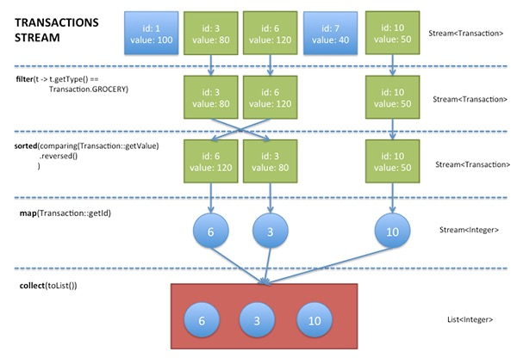
Step by Step
Notes:
a sequence of elements from a source that supports aggregate operations.” Streams consume from a source such as collections, arrays, or I/O resources. Streams support the common operations from functional programing languages, such as map, filter, reduce, find, sorted, etc

Slide 18
Assembly Line
Notes:
a sequence of elements from a source that supports aggregate operations.” Streams consume from a source such as collections, arrays, or I/O resources. Streams support the common operations from functional programing languages, such as map, filter, reduce, find, sorted, etc

Slide 19
Intermediate Operations
filter excludes all elements that don’t match a Predicate.
map performs a one-to-one transformation of elements using a Function.
sorted sort all the elements according to a the Comparable implementation of the element type or according to a Comparator
Notes:
intermediate operation keeps a stream open for further operations. Intermediate operations are lazy

Slide 20
Terminal Operation
forEach performs an action for each element of this stream
collect performs a mutable reduction operation on the elements of this stream using a Collector
Notes:
Once a terminal operation is invoked, the stream is consumed and is no longer usable

Slide 21
Stream concept from Akka
Source
Sequence of elements, arrays, collection, list, set
Flows
Intermediate operation
Aggregate operation
Pipelining
Internal iteration
Lazy evaluation
Sink
Final operation
Make the computation happen
Boss

Slide 22

Blablabla, Boring theory

Slide 23
Parallel Programming
Before Java 5
Thread, Runnable, Synchronized, volatile
From Java 5
Executor, ExecutorService, Future, ReentrantLock
Fork/Join framework from Java 7
Out-of-box feature we can use? → ParallelStream

Slide 24
Parallel Stream
List<Integer> numbers = Arrays.asList(0,4,5,6,2,3,1,8,7,9,56,17,29);
// sequetial sorting numbers.stream().sorted().forEach(System.out::println);
// parallel sorting numbers.parallelStream().sorted().forEach(System.out::println);
Notes:
Then 2 code examples will be followed
Test the time saving
Show the parallel stream what it is doing under the hood, unveil the mystery of parallelstream

Slide 25
Avoid Mutation
List<Person> persons = Arrays.asList( new Person("perter", 24), new Person("ian", 30), new Person("jacob", 3), new Person("angela", 28), new Person("mike", 24), new Person("steve", 60), new Person("andy", 30), new Person("jack", 15));
List<Person> sortedPersons = new ArrayList<>(); persons.stream() .sorted((p1, p2) -> (p1.getAge() - p2.getAge() > 0 ? 1 : -1)) .forEach(person -> sortedPersons.add(person));
Notes:
One of the main purposes of lambdas is use in parallel computing – which means that they’re really helpful when it comes to thread-safety.

Slide 26

Mutation Anti Pattern

Slide 27

Avoid Mutation
List<Person> persons = Arrays.asList( new Person("perter", 24), new Person("ian", 30), new Person("jacob", 3), new Person("angela", 28), new Person("mike", 24), new Person("steve", 60), new Person("andy", 30), new Person("jack", 15));
//immutable sort, good practice List<Person> sortedPersons = persons.stream() .sorted((p1, p2) -> (p1.getAge() - p2.getAge() > 0 ? 1 : -1)) .collect(Collectors.toList());
//immutable sort, good practice Person[] sortedPersons = persons.stream() .sorted((p1, p2) -> (p1.getAge() - p2.getAge() > 0 ? 1 : -1)) .toArray(Person[]::new));
Notes:
Till now I have covered the stream

Slide 28
Benefits of Stream
SQL-Like Operation
Declarative
Lazy evaluation
Promote immutability
Easier parallelization
Clean and concise code

Slide 29
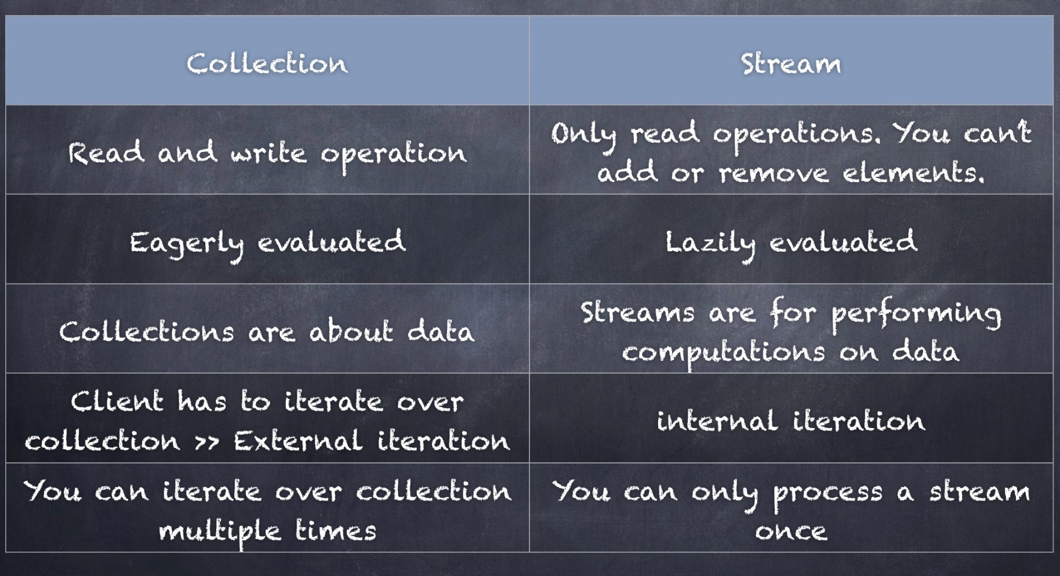
Stream vs Collection
Notes:
If you don’t want to use the steam, why do I bother computing it for you

Slide 30
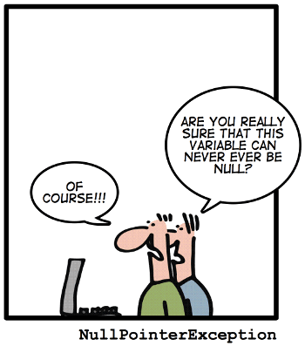
NPE

Slide 31
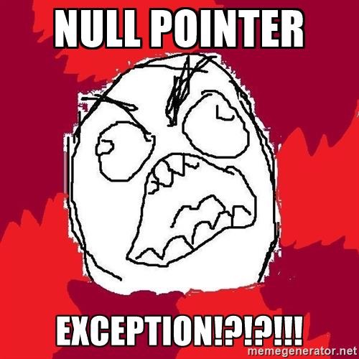
NPE? Annoying

Slide 32

NPE How to deal with it

Slide 33
Optional<T>
A container which may or may not contain a non-null value
Common methods
isPresent() – returns true if value is present
get() – returns value if present
orElse(T other) – returns value if present, or other
ifPresent(Consumer) – runs the lambda if value is present

Slide 34
Optional<T> with Value in it
Optional<String> optionalGoal = Optional.of("goal");
System.out.println(optionalGoal.get());
System.out.println(optionalGoal.orElse("fallback"));
optionalGoal.ifPresent((s) -> System.out.println(s.charAt(0)));

Slide 35
Optional<T> with Null
Optional<String> optionalNull = Optional.ofNullable(null);
System.out.println(optionalNull.isPresent());
System.out.println(optionalNull.orElse("fallback"));
optionalNull.ifPresent((s) -> System.out.println(s.charAt(0)));
optionalNull.orElseThrow(
() -> new IllegalArgumentException("there is no element in it")
)

Slide 36
Optional<T>
Benefits
Null checks are not required.
Much less likely to have NPE at run-time.
Better readability.
Better maintainability.
But …
Optional is not meant to be used in these contexts
the domain model layer (not serializable)
DTOs (same reason)
input parameters of methods
constructor parameters
Notes:
Optional is not meant to be used in these contexts
in the domain model layer (not serializable)
in DTOs (same reason)
in input parameters of methods
in constructor parameters

Slide 37
Adoption in TDP 4
Four realistic scenarios
Apply Lambda, Stream and Optional
Initially not easy
Complex Domain Model
Notes:
Full attention, otherwise lose me quickly

Slide 38
Scenario 1
profileInfos = OrderAssessUtils.retrieveProfileInfo( new ServiceCaller() { @Override public Object invoke(Object rq) { return callServant(PROFILERETRIEVEBEANNAME, rq, ProfileRetrieveSvRS.class); } }, sessionInfo, clientId, M3_ContextCodes.ORDER_ASSESS_ACTIONS_CONTEXT_CODE, M3_MajorCodes.ORDER_ASSESS_ACTIONS_MAJOR_CODE

Slide 39
Scenario 1 Adoption
Improved by using λ
profileInfos = OrderAssessUtils.retrieveProfileInfo( rq -> callServant(PROFILERETRIEVEBEANNAME, rq, ProfileRetrieveSvRS.class), sessionInfo, clientId, M3_ContextCodes.ORDER_ASSESS_ACTIONS_CONTEXT_CODE, M3_MajorCodes.ORDER_ASSESS_ACTIONS_MAJOR_CODE );

Slide 40
Scenario 2
public static ResComponent getPrimaryResComponent(ResComponentGroup resCompGroup, Reservation res) { if (resCompGroup.getGroupMemberCount() > 0) { for (GroupMember groupMember : resCompGroup.getGroupMember()) { if (groupMember.hasPrimaryComponent() && groupMember.hasResComponentSequence()) { ResComponent resComp = ResComponentUtil.getResComponent(res,
groupMember.getResComponentSequence()); if (resComp != null) { return resComp; } } } } return null; }

Slide 41
Scenario 2 Adoption
Improved by using λ, Stream and Optional
public static ResComponent getPrimaryResComponent(ResComponentGroup resCompGroup, Reservation res) { return Arrays.stream(resCompGroup.getGroupMember()) .filter(gm -> gm.hasPrimaryComponent() && gm.hasResComponentSequence()) .map(gm -> ResComponentUtil.getResComponent(res, gm.getResComponentSequence())) .findFirst() .orElse(null); }

Slide 42
Scenario 3
private static List<String> getAllPolicyCodeWithResCompSequence1(List<Reservation> reservations)
{ List<String> policyCodes = new ArrayList<>(); for(Reservation reservation : reservations){ for(ResComponent resComponent : reservation.getResComponents()) if (resComponent.getSequence() == 1) { for (Policy policy : resComponent.getPolicies()) { if(policy.getPolicyCode() != null) policyCodes.add(policy.getPolicyCode()); } } } return policyCodes; }

Slide 43
Scenario 3 Adoption
Improved by using λ, Stream
private static List<String> getAllPolicyCodeWithResComSequence1(List<Reservation> reservations) { return reservations .stream() // .parallel() .map(reservation -> reservation.getResComponents()) .flatMap(resComponentList -> resComponentList.stream()) .filter(resComponent -> resComponent.getSequence() == 1) .map(resComponent -> resComponent.getPolicies()) .flatMap(policyList -> policyList.stream()) .map(policy -> policy.getPolicyCode()) .collect(toList()); }

Slide 44
Scenario 4
Validate the reservation in request, in case there is no policy code in rescomponent, throw an AnyException
private static void validatePolicyCodeExistence(List<Reservation> reservations) { List<String> policyCodes = new ArrayList<>(); for(Reservation reservation : reservations){ for(ResComponent resComponent : reservation.getResComponents()) for (Policy policy : resComponent.getPolicies()) { if(policy.getPolicyCode() != null) policyCodes.add(policy.getPolicyCode()); } } if (policyCodes.size() == 0) { throw new AnyException("there is no policy code, invalid request"); } }

Slide 45
Scenario 4 Adoption
Improved by using λ, Stream and Optional
private static void validatePolicyCodeExistence(List<Reservation> reservations) { reservations
.stream() .map(reservation -> reservation.getResComponents()) .flatMap(resComponentList -> resComponentList.stream()) .map(resComponent -> resComponent.getPolicies()) .flatMap(policyList -> policyList.stream()) .map(Policy::getPolicyCode) .findAny() .orElseThrow(() -> new AnyException(" there is no policy code, invalid request ")); }

Slide 46


Slide 47

More Enjoyable on Github!
https://github.com/shaojie-xu-kp/java8_lunch_learn.git

Slide 48


